Slide 1
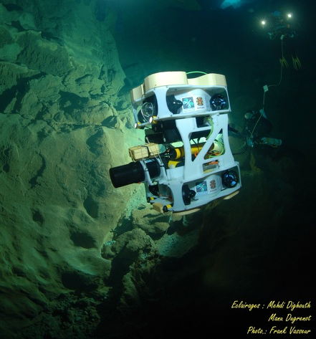

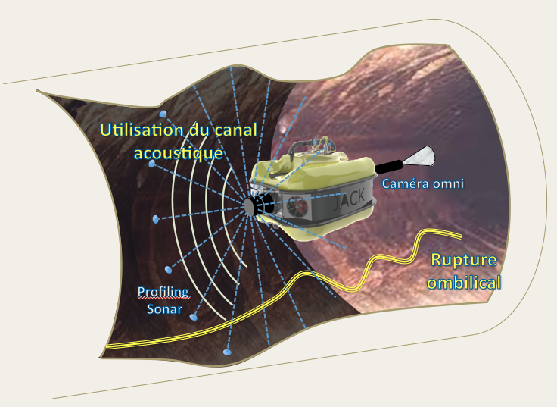

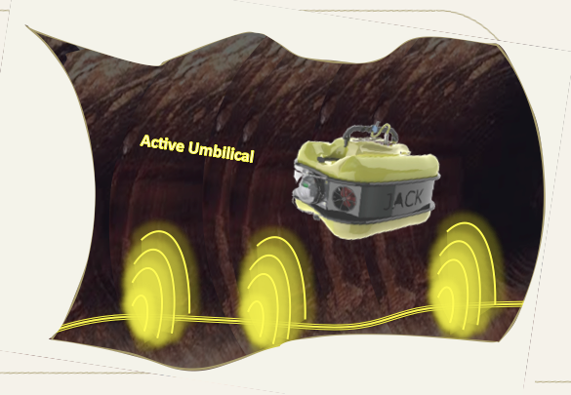
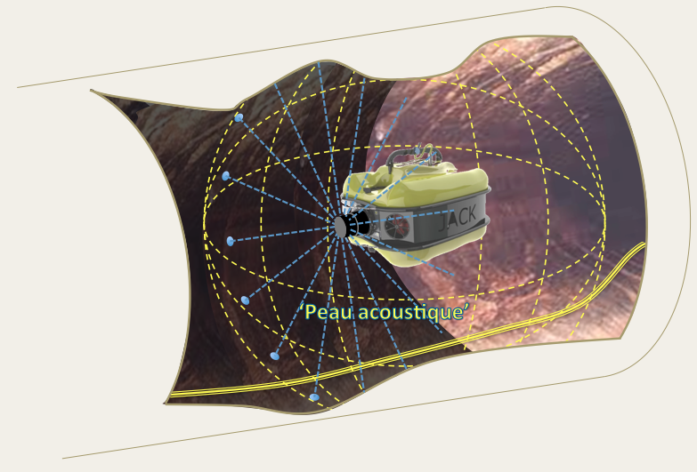
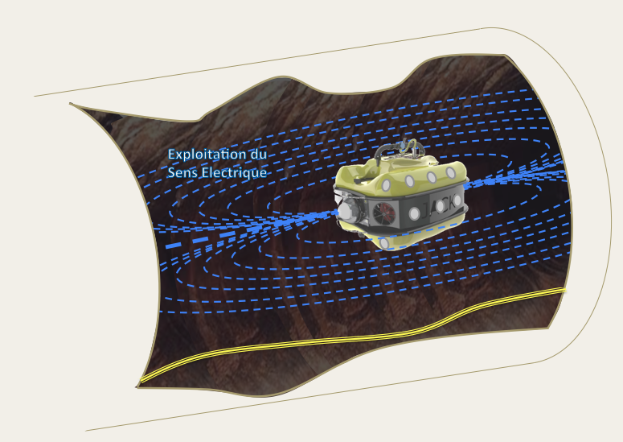
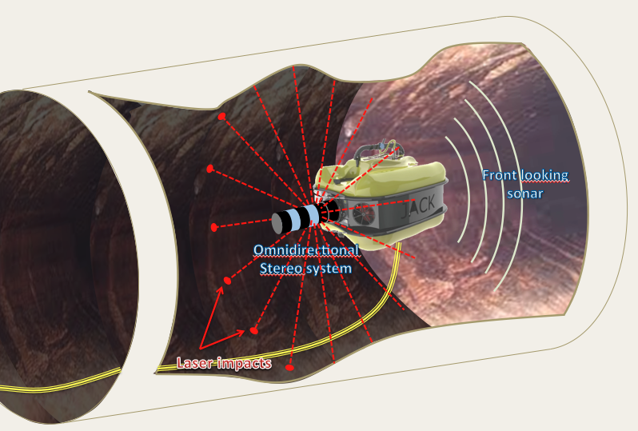

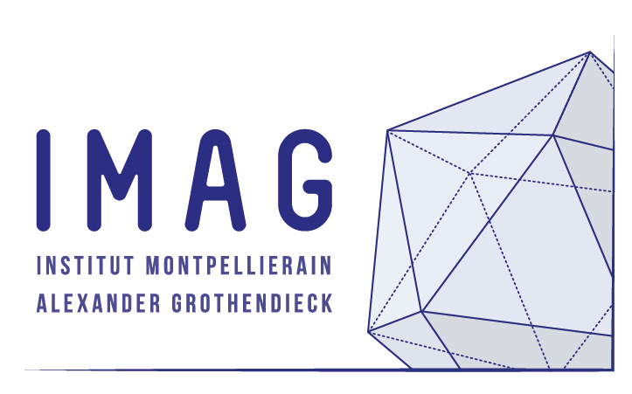

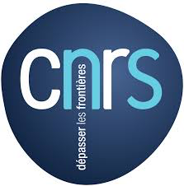


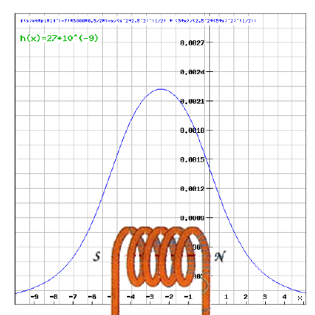
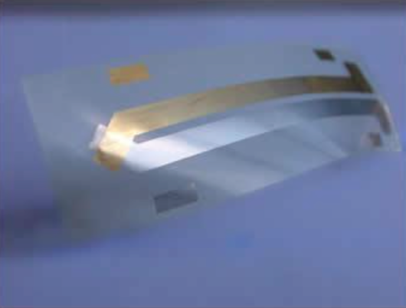
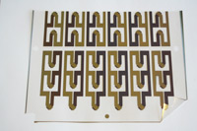
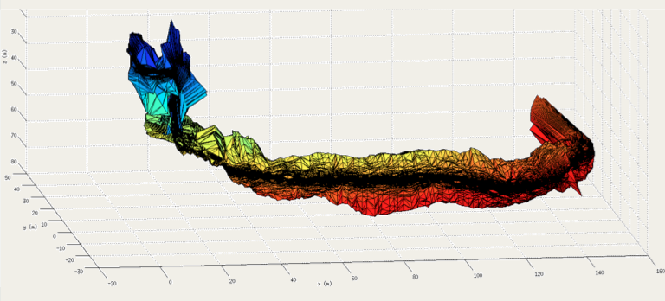
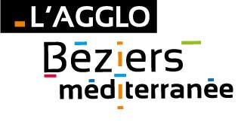

ALEYIN, SYSTEMS FOR KARST EXPLORATION
Prospection/Protection/Management of water Resource
Hydrologic Risk Management, Forecasting and Decision
Understanding Karst dynamics, Cartography, Instrumentation, Models
Spin-off creation : REEDS
Environment
Vector
Exploration : Wired, Raw data acquisition, model construction, co-control
Return phase : Unwired, Model exploitation, autonomous navigation
New Sensors
nD
Models
Contact : lapierre@lirmm.fr

